Slide 1
GO Team Meeting #1
Sylvan Hills Middle School September 20, 2023

Slide 2
Agenda
Call to Order
Norms
Roll Call
Action Items
Approval of Agenda
Approval of Previous Minutes
Discussion Items
SHMS CIP & Strategic Plan
Progress on the Strategic Plan Priorities
Ranking Strategic Plan Priorities
Spring 2023 MAP vs Fall 2023 MAP
Information Items/ Announcements
Leveling Report
Homecoming Game & Dance
New Asst. Principal Start Date
Adjournment

Slide 3
Let’s commit to:
Being present and engaging meaningfully so that we can learn from each other (i.e. Cameras on)
Muting your microphone (VIRTUAL) and minimizing extraneous conversations
Assuming good will
Allowing all voices of the team to be heard
Focusing on the day’s content
Starting and ending on time
Being gracious

Slide 4
Action Items
.
Action Items
Approval of Agenda
Approval of Previous Minutes
Ms. Crawley-James

Slide 5
TOPICS
School CIP
Strategic Plan & Priorities Review
SMART Goals
Data Discussion
Spring MAPS
GMAS
Principal’s Report
Current Enrollment & Leveling
Information about our school

Slide 6
GO TEAM MEMBERS 23-24
NAME | ROLE
Mr. Larry A. Guilford | Principal
Ms. Jessica Bracey | Parent
Ms. Devette Wilson | Parent
Ms. Qiana Gordon | Parent
Ms. Jayla Bailey | Staff
Ms. Diamond Leben | Staff
Ms. Sabrina Crawley- James | Staff
Mr. Durand Bailey | Community Member
Mr. Tony Owens | Community Member
Ms. Cassandra Mack | Swing Seat

Slide 7
2021-2025 Strategic Plan

Slide 8
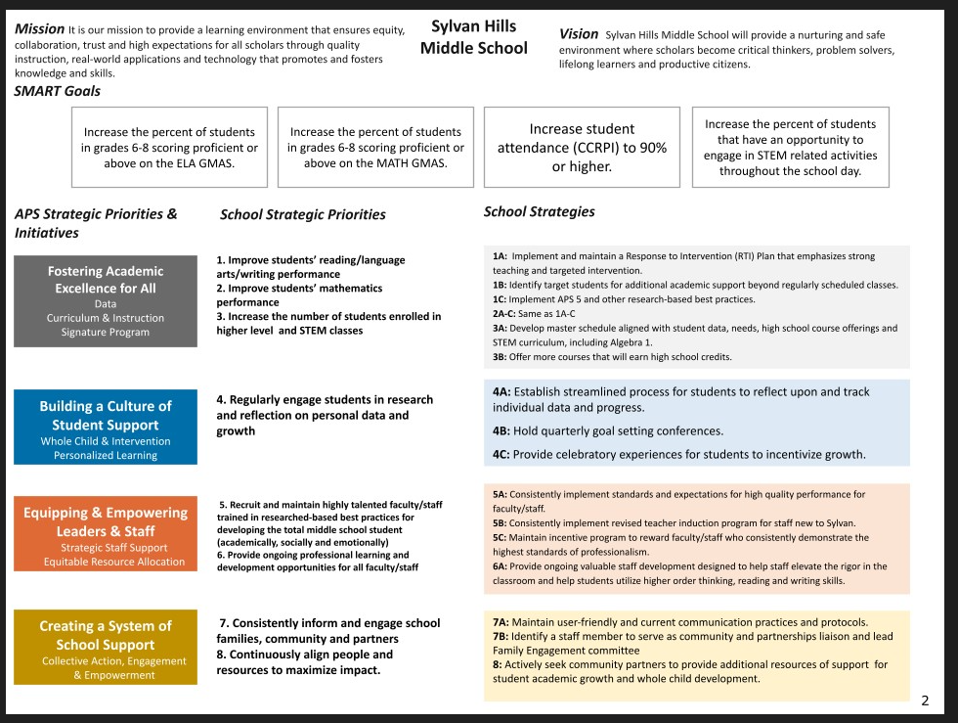
School Name
Mission
Vision
SMART Goals
Increase the percent of students in grades 6-8 proficient or above on the MATH GMA
Increase
TBD
APS Strategic Priorities & Initiatives
School Strategic Priorities
School Strategies
1A. tbd
1B. tbd
1C. tbd
Fostering Academic Excellence for All Data
Curriculum & Instruction Signature Program
Building a Culture of Student Support
Whole Child & Intervention Personalized Learning
TBD: tbd
TBD: tbd
4.
Equipping & Empowering Leaders & Staff
Strategic Staff Support Equitable Resource Allocation
6.
7.
TBD: tbd
Creating a System of School Support
Strategic Staff Support
Equitable Resource Allocation
8.
9.
TBD: tbd
14

Slide 9
Strategic Plan
Priority Ranking
Insert the school’s priorities from Higher to Lower
Higher
Improve students’ mathematics performance
Improve students’ reading language arts/ writing performance
Regularly engage students in research and reflection on personal data and growth
Provide ongoing professional learning and development opportunities for all faculty/staff
Consistently inform and engage school families, community and partners
Recruit and maintain highly talented faculty/staff
Increase the number of students in higher level and STEM classes
Continuously align people and resources to maximize impact
Lower

Slide 10
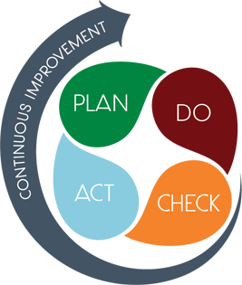
Connecting the Strategic plan & Continuous Improvement Plan
Strategic Plan Priority
CIP SMART GOAL
KEY INDICATOR
Strategic Plan Priority
CIP SMART GOAL
KEY INDICATOR
Strategic Plan Priority
CIP SMART GOAL
KEY INDICATOR

Slide 11
Data Discussion

Slide 12
MAP COMPARISON DATA
SCHOOL vs DISTRICT
2%
1%
What do you notice? What do you note? What do you wonder?
Notes:
Benchmark data needs to be pulled again

Slide 13
MAP COMPARISON DATA
Subgroup
Gifted
SWD
What do you notice? What do you note? What do you wonder?
Notes:
Benchmark data needs to be pulled again

Slide 14
MAP COMPARISON DATA
Grade Level Comparison
Fall 22-23
2%
2%
3%
Fall 23-24
2%
1%
What do you notice? What do you note? What do you wonder?
Notes:
Benchmark data needs to be pulled again

Slide 15
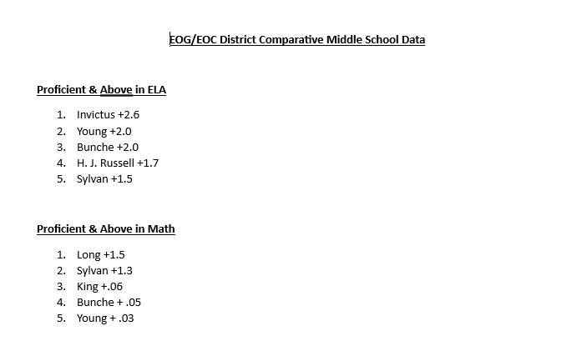
GMAS Results

Slide 16
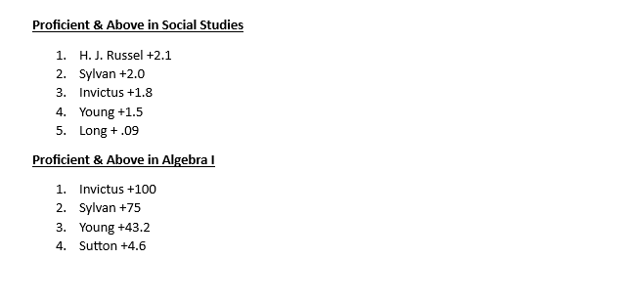
GMAS Results

Slide 17
Glows & Grows
Glows
Grows
are we on target to successfully ACCOMPLISH our priorities?
IMPACT

Slide 18
GO Team Discussion: Data Protocol
What do you notice?
What are your wonderings?
What additional questions do you have?

Slide 19
Timeline for GO Teams
You are HERE
Fall 2021
GO Team Developed 2021-2025 Strategic Plan
1
Summer
School Leadership completed Needs Assessment and defined overarching needs for SY22-23
2
August
School Leadership completed 2022-2023 Continuous Improvement Plan
3
Sept. – Dec.
Utilizing current data, the GO Team will review & possibly update the school strategic priorities and plan
4
Before Winter Break
GO Team will take action (vote) on the rank of the strategic plan priorities for SY23-24 in preparation for budget discussions.
5

Slide 20
Questions?

Slide 21
Principal’s Report

Slide 22
Enrollment
Projected Enrollment | 418
Current Enrollment | 441
Difference | 23
Leveling
Leveling is the process the District uses to adjust school budget allocations to match student enrollment.
Budget Impact | (Principal: input change in allocation for your school and discuss how you are going to address the change in allocation)
Notes:
Principals: Based on your enrollment, please give your GO Team the information on how you plan to account for any budget changes due to leveling.

Slide 23
Information about our school
Community Partners
Student Engagement
STEAM
Houses
Parent Engagement

Slide 24
Questions?

Slide 25
Plan for AT LEAST 3 of your GO Team members to attend!

